Slide 1
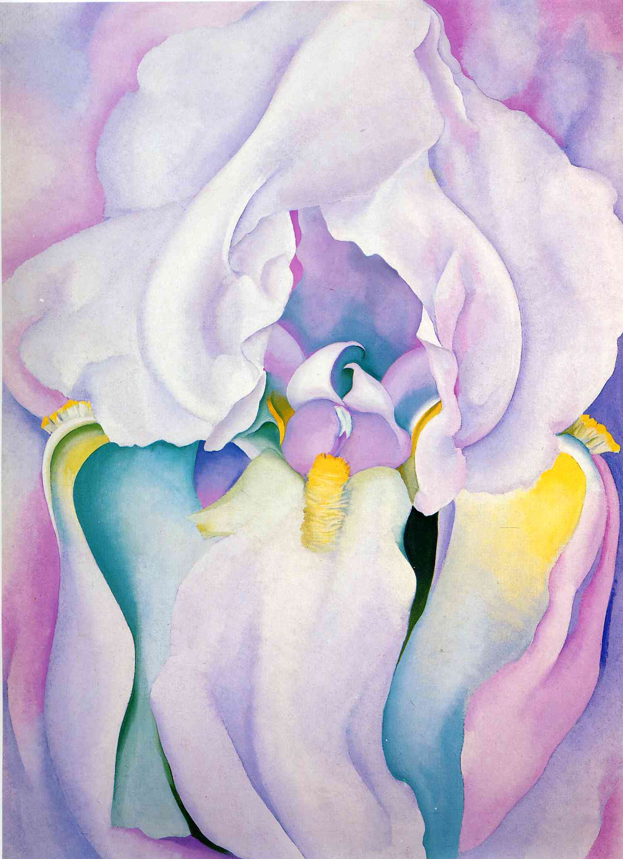
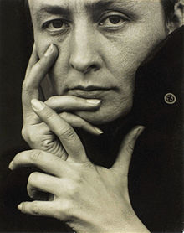
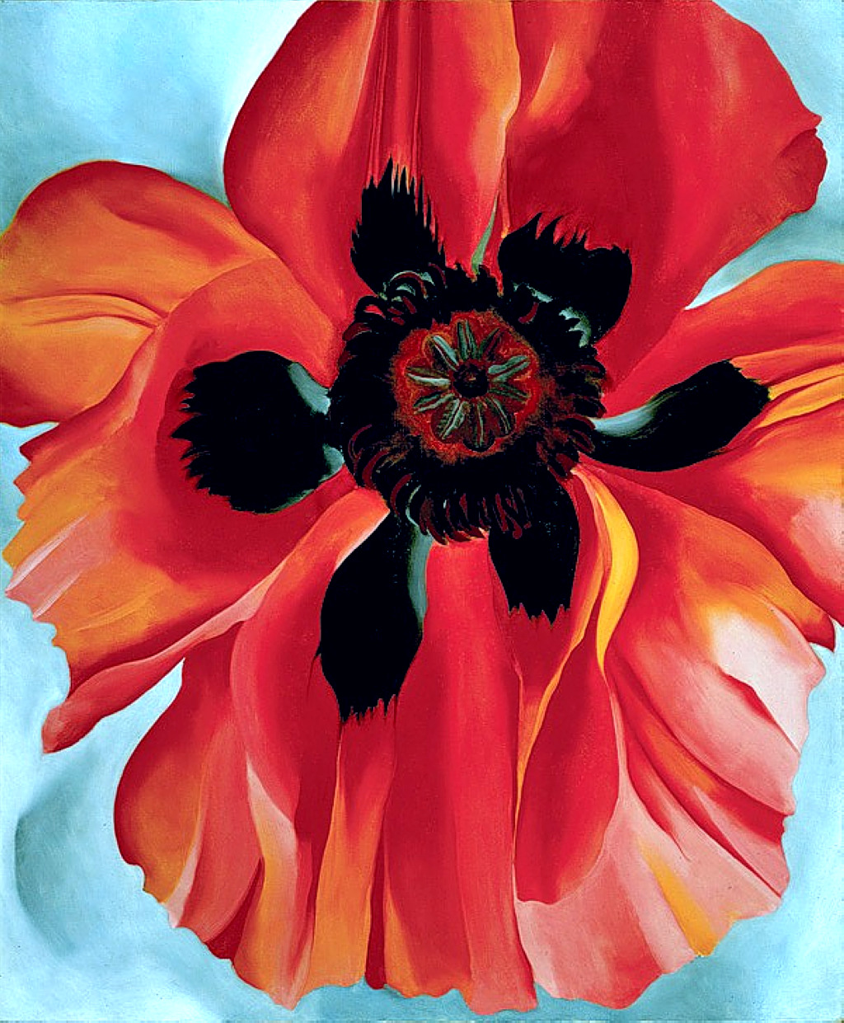
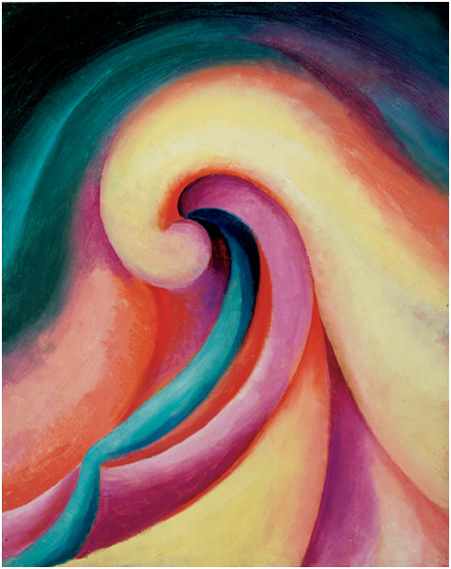
Get to Know an Artist: Georgia O’Keeffe
“I’m frightened all the time! But I never let it stop me! Never!
Notes:
Lesson 1: The Artist and her subject
Questions:
What do you think the artist is frightened of? Why?
Have you been scared of anything?
What are the things you are frightened of when you do art?
What do you say to a person who doesn’t like your artwork?
If you don’t like an artwork by your friend? Do you think you should say anything? If yes, What would would you say?
What do you think Georgia O’Keefe likes to paint?
Do you like flowers? Why?
Why do you think Georgia O’Keeffe likes flowers so much?
Can you tell me the different parts of a flower?
Task 1: Sketch a flower in your Sketch Book (10 mins)

Slide 2
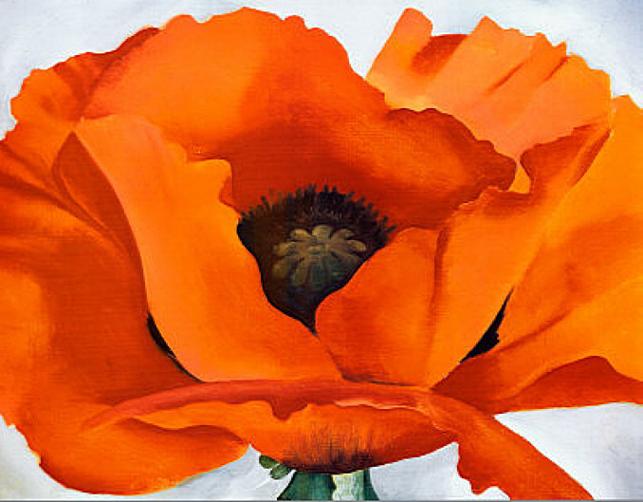
Who was she?
An American painter born in 1887, in Wisconsin.
She wanted to be a painter ever since she was ten years old!
She was fearless and painted the way she wanted to, even though she was taught realism.
Notes:
Realism: Painting things the way it is seen.

Slide 3
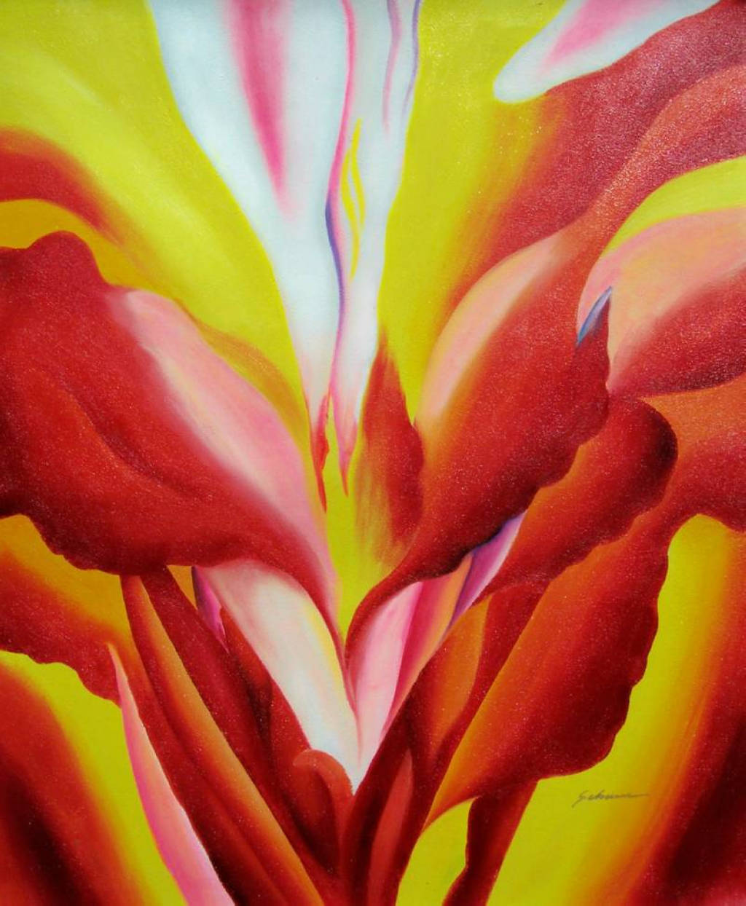
Who was she?
One day, a photographer called Alfred Stieglitz, saw one of her paintings.
He put it in his gallery and Georgia became famous.
Georgia and Alfred got married.
Why do you think Alfred liked Georgia’s paintings?
Notes:
Realism: Painting things the way it is seen.

Slide 4
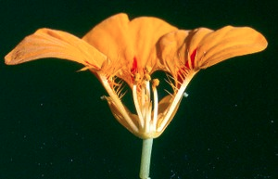
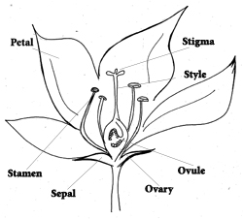
Getting to know a flower
Notes:
Task 2: Draw a labelled flower right below the first drawing of a flower. (10 minutes)

Slide 5
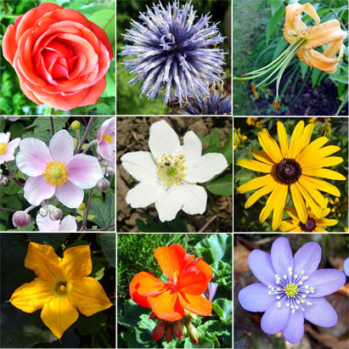
Different types of flowers
Notes:
Share the differences in the flowers, with your friends.
Pupils to sketch different petal shapes.

Slide 6
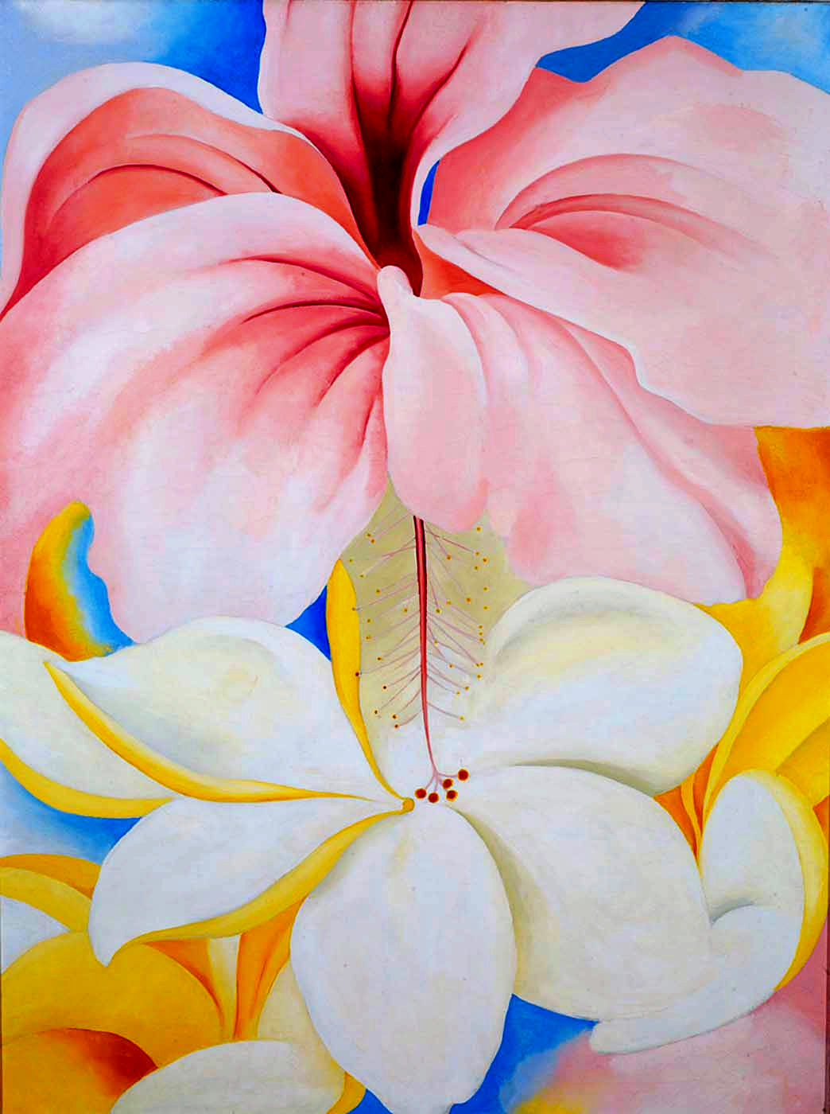
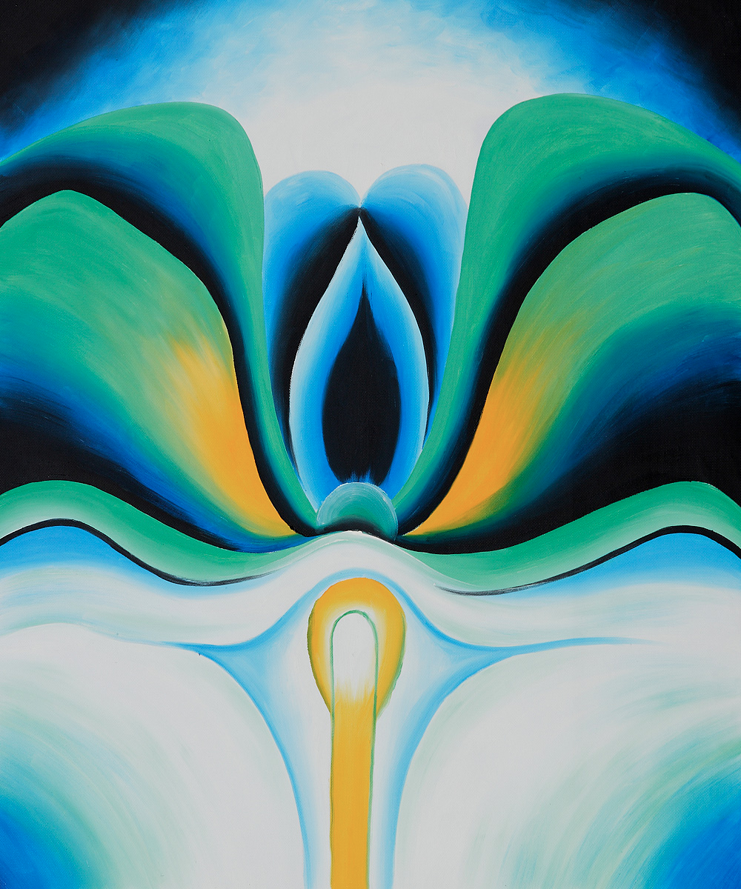
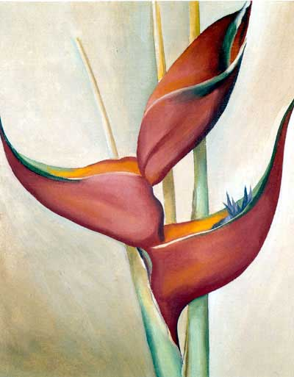
Her paintings
Notes:
Lesson 2: Elements and Principles
Element: Colour (Cool vs Warm)
Imagine very cold rainy day. You are outside, shivering. What does it look like? What colours do you see?
Imagine a warm, sunny day. You are at the beach. What does it look like? What colours do you see?
What are the cool colours you can see in Georgia’s paintings?
Principle: Balance
Imagine carrying a 10kg bag of marbles in one hand and a 1kg bag of marbles in the other.
What will happen after a while?
Balance in an artwork is the same thing. You must arrange things so that it looks balanced.
Are Georgia’s paintings balanced? How do you know?
Task 3: Use colour pencils to colour your first flower in cool colours and for your second flower, use warm colours. (15 mins)

Slide 7
Our Final Art Project
Notes:
Name all the materials we need.
Ans:
Oil pastel
Watercolour
Patterned paper
Scissors and Glue
How do you think this art work is done?

Slide 8
Step by Step Guide
Draw spirals with oil pastels.
You are advised to use more than one colour.
Have a combination of cool and warm.

Slide 9
Step by Step Guide
Use water colour and paint over the spirals.
This is called “wax resist” because oil pastels are water proof.

Slide 10
Step by Step Guide
Cut out your very own idea of a flower.
Paste it on the spiral-paint paper neatly.
Remember to keep your artwork balanced.

Slide 11
Artworks by other young artists

Slide 12
What have you learnt?
What was Georgia O’Keeffe’s favourite subject matter?
Share what you know about warm and cool colours.
Share what you know about balance.
What art method did you use to make your artwork?
What did you enjoy most about the lessons?
Notes:
Share students’ final artworks with the class.

