Slide 1
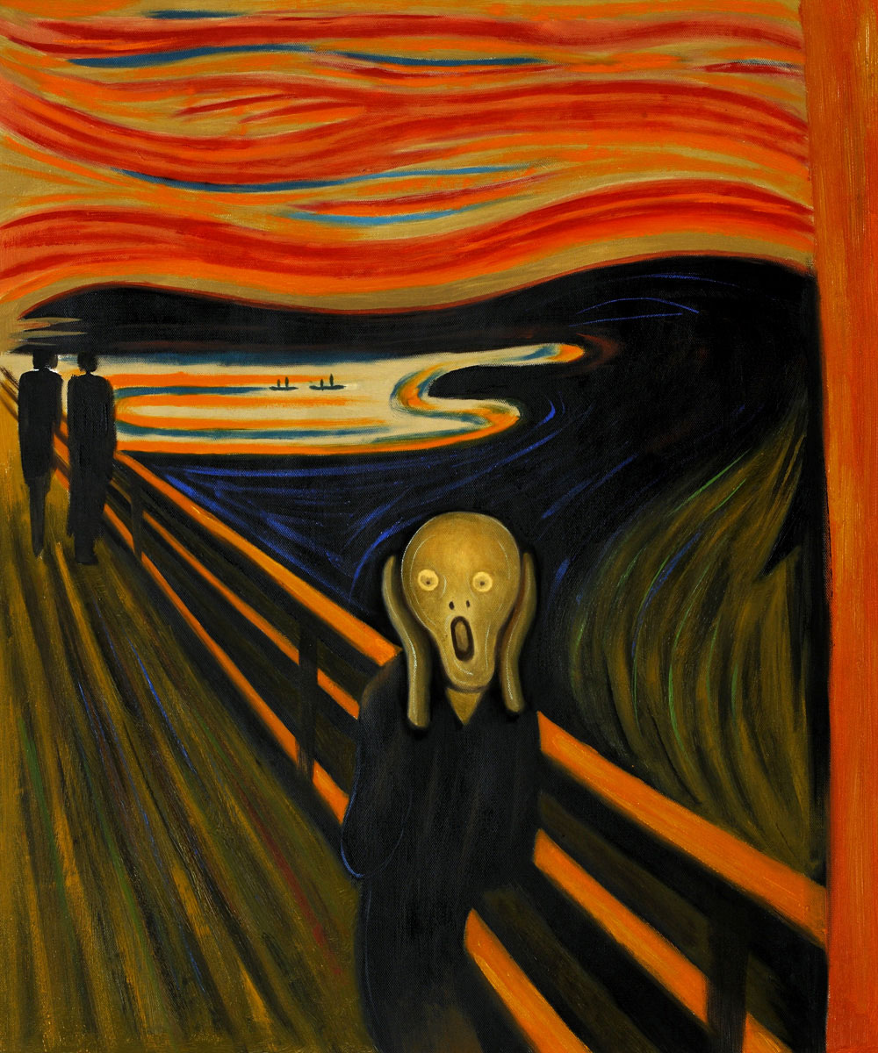
What do you see?
What do you think is in front of him?

Slide 2
So When do you scream?
...when you are afraid
...when you are shocked
...when you are surprised

Slide 3
Will you scream when you see a...

Slide 4
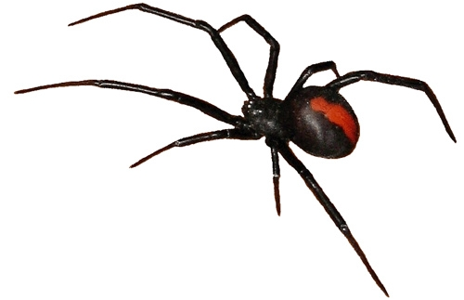
Spider

Slide 5
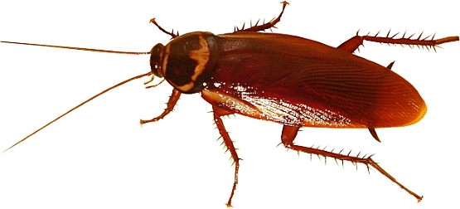
Cockroach

Slide 6
Ghost

Slide 7
Pretend that you are in a jungle.
Suddenly you hear a loud roar.
How do you feel now?
Then you look up and you saw a ...

Slide 8
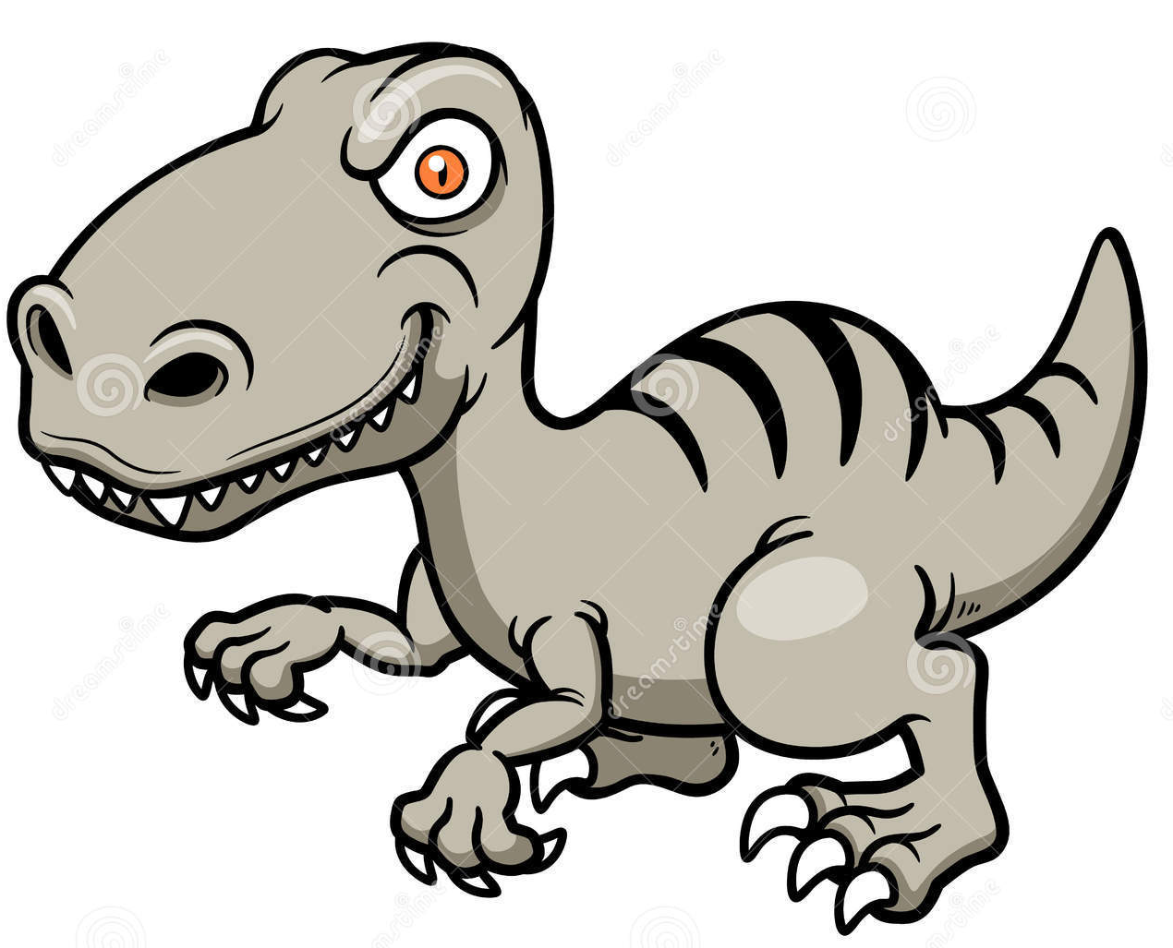
You scream!

Slide 9
When you are afraid, how do you look like when you scream?

Slide 10
We are going to do a self portrait when you scream!
we will be using oil pastel and a bit of paint

Slide 11
