Slide 1
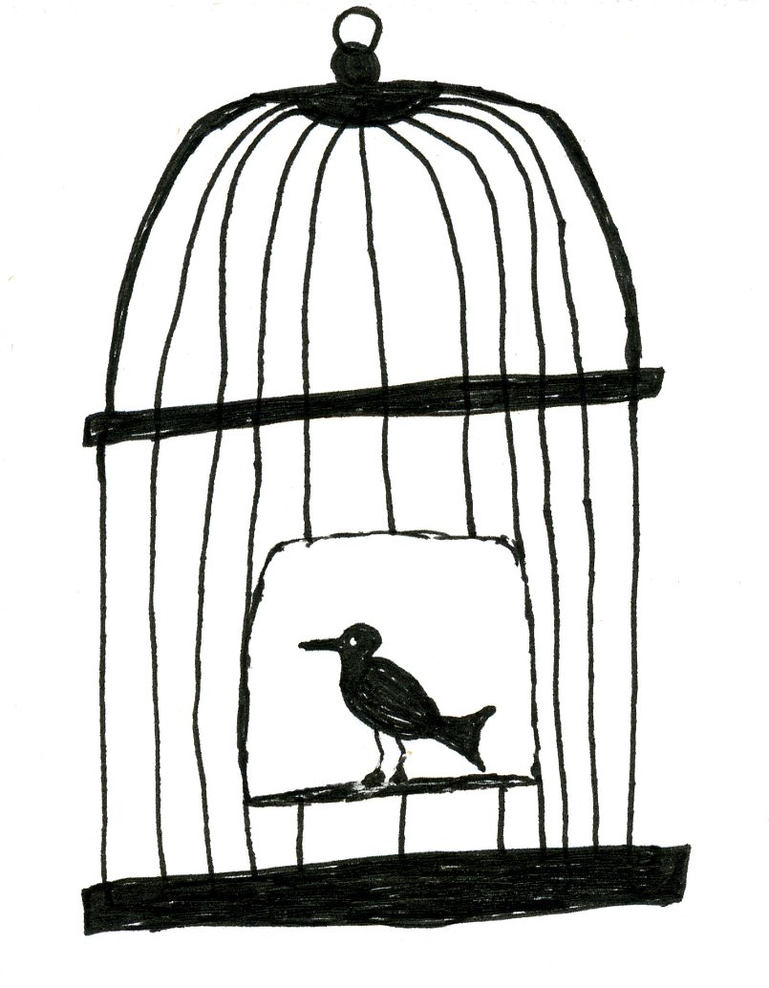
Uncaged Quetzals

Slide 2
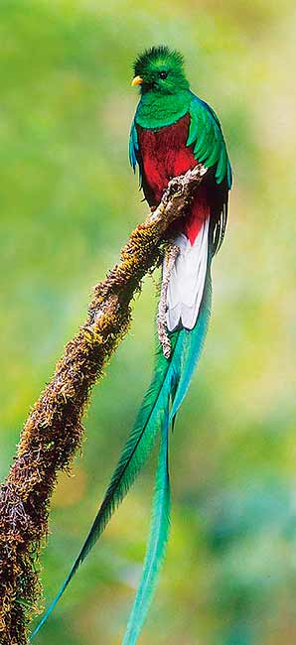
What are Quetzals?
The Quetzals live in the canopy layer of the rainforest in Central America.
They eat lizards, bugs and insects when young. They also eat fruits, but mainly wild avocados when older.
Quetzals are hard to find because they nest only in the tallest and oldest trees in the rainforest that are at least 3,600 feet above sea level.
Look at the picture on the left
And describe the quetzal.

Slide 3
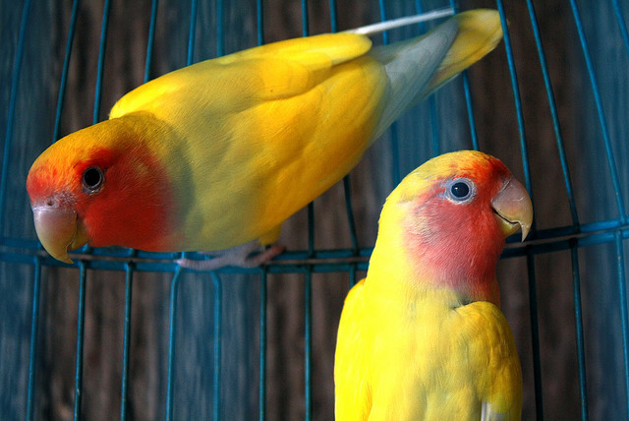
Questions to discuss
Do you believe that birds belong in cages?
How do you feel about birds being kept in Jurong Bird Park?
What is the difference between a caged and an uncaged bird?

Slide 4
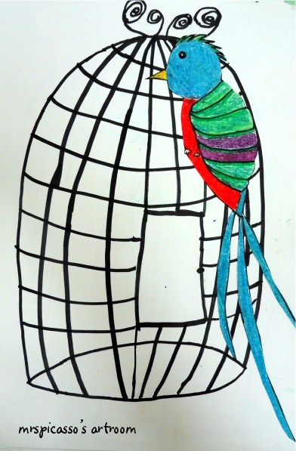
Your Task
Draw an uncaged Quetzal to symbolise freedom and beauty!

Slide 5
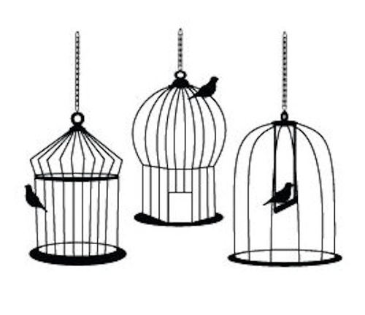
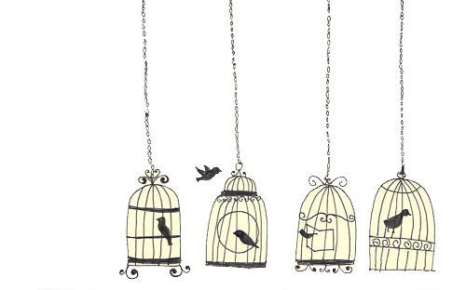
How?
Look at the cages below. Choose a design and use curved lines to draw it. (Portrait mode)
You may use a pencil first, and then outline it with black marker.

Slide 6
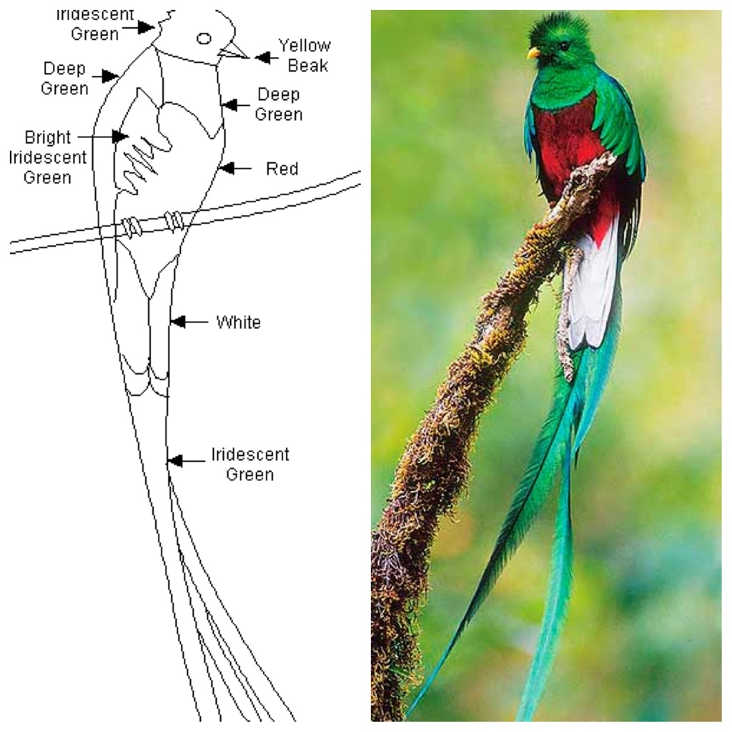
How?
On another piece of paper, draw a quetzal using the drawing below as a guide.
Colour it using oil pastels.

Slide 7
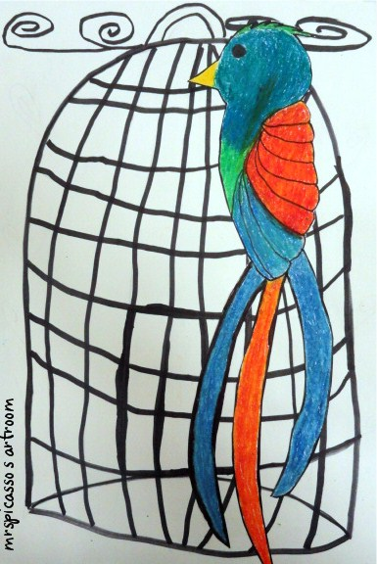
How?
Cut out the coloured Quetzal and paste it on the cage which you have drawn earlier.
Share your artwork with your teacher and friends

