Slide 1
Lesson 1
Contour Drawing
Understand the element of art: LINE

Slide 2
What is a line?

Slide 3
a line
is made up of
many
dOts
Notes:
A line is made up of many dots

Slide 4
A line of dots
creates
a direction.
Many dots are put together
to form
a shape.
Notes:
Many dots are put together
to form a shape.. Triangle.
Human eyes tend to join the dots that we see together
to form into something with more meaning.

Slide 5
.. or an image.
Like lines, dots can be used to create a
design, example
a necklace.
Notes:
or an image
A line of dots
creates
a direction.
You can use dots to
design.

Slide 6
Lines can be found everywhere & anywhere
Notes:
Lines can be found everywhere & anywhere

Slide 7
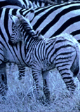
On animals
as strips on a zebra
Notes:
On animals
as strips on a zebra

Slide 8
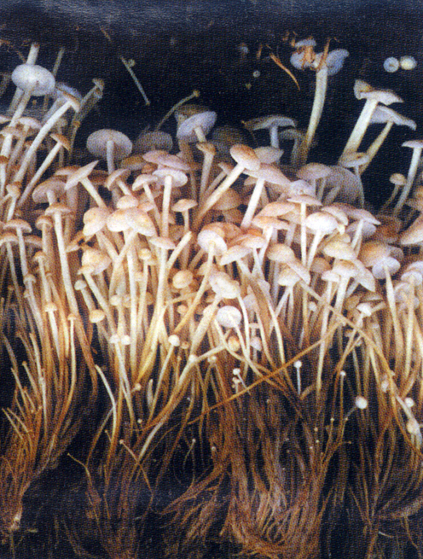
On plants
as the shape of the
mushroom itself
Notes:
On plants
as the shape of the
mushroom itself

Slide 9
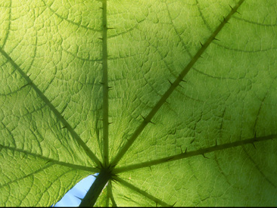
Thick & Thin Lines
1
3
Straight Line
Curvy Line
2
We can find
different types of lines
on a leaf.
Notes:
What kind of lines can we see here?
Straight lines
Curvy lines
Thick & Thin lines

Slide 10
What are the different types of lines?
Notes:
What are the
Different types of lines?

Slide 11
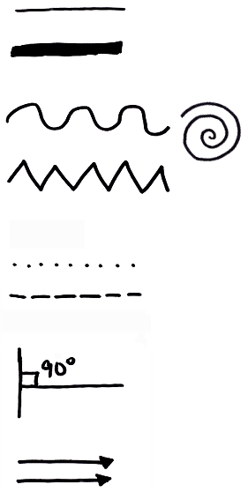
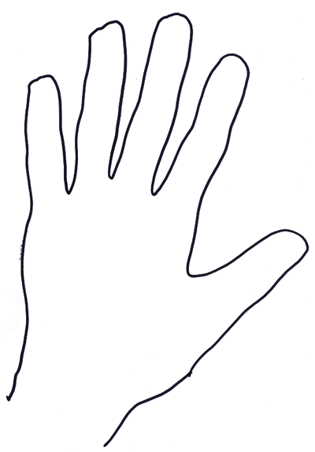
Different types of lines
Straight,
Thick & Thin lines
Curvy line,
Spiral &
Zig-zag
Dotted &
Dashed lines
an Outline
of my hand
Horizontal & Vertical,
Perpendicular lines
Parallel lines

Slide 12
Lines can convey feelings
Notes:
What are the
Different types of lines?

Slide 13
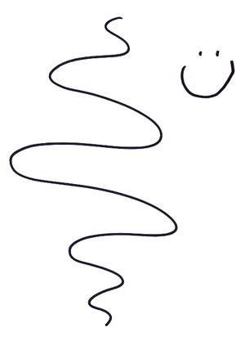
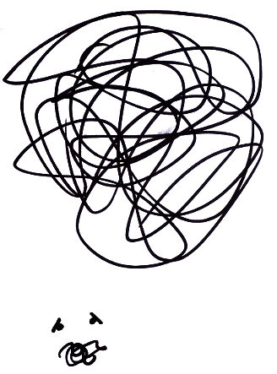
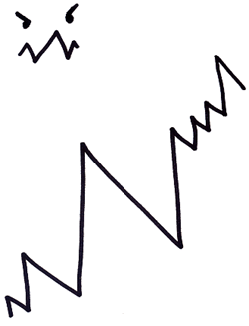
Curvy Edge
= Happy
Sharp Edge
= Angry
Messy Edge
= Confused

Slide 14
Artists' Works

Slide 15
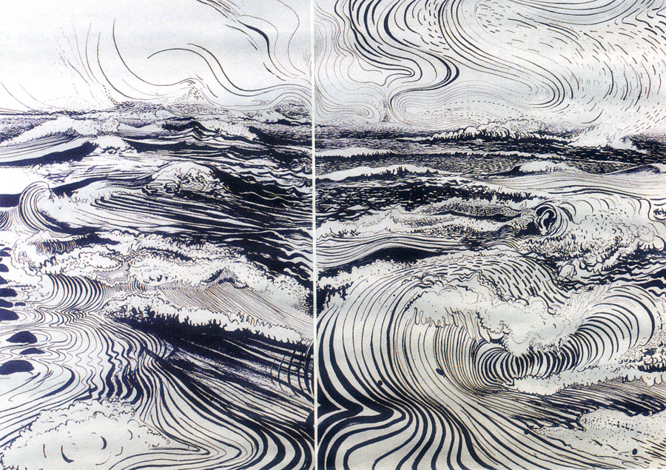
Lines show direction of the wind
Lines show splashing power of the waves
Lines can convey feelings - passion
Notes:
The Artist uses wavy lines to show the
● direction of the wind in the skies and
● the splashing power of the waves
This shows that lines can convey feelings.

Slide 16
Lines can convey our creativity

Slide 17
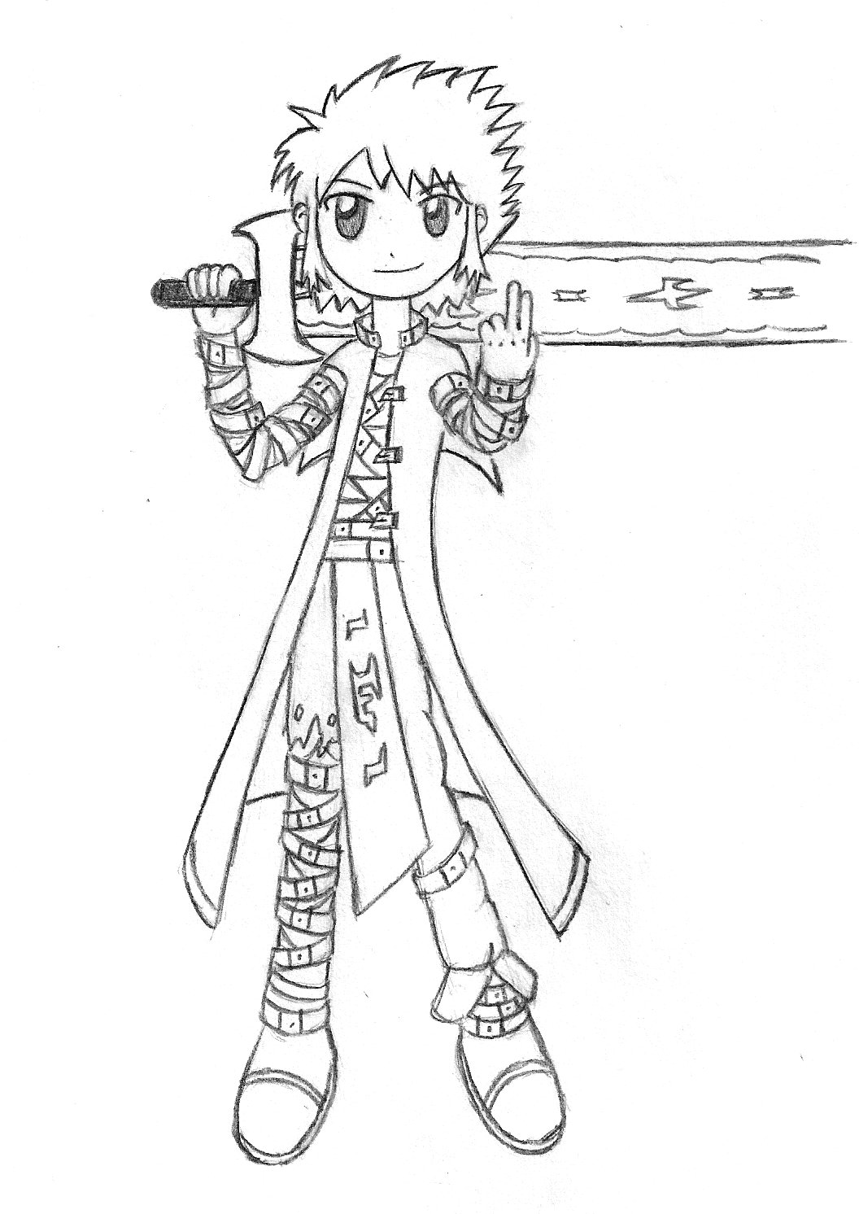
Lines can convey our love for cartoons

Slide 18
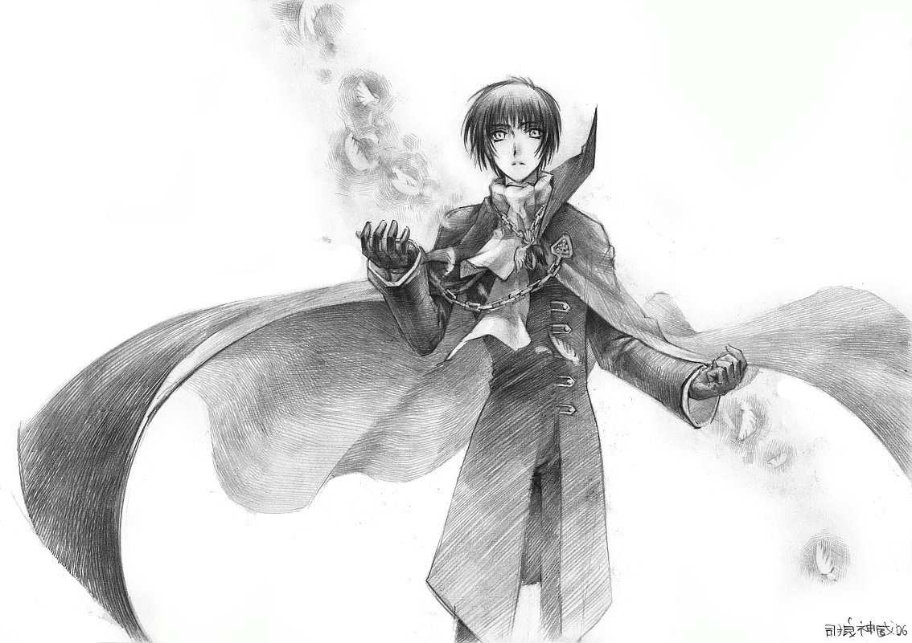
Lines can convey our love for manga

Slide 19
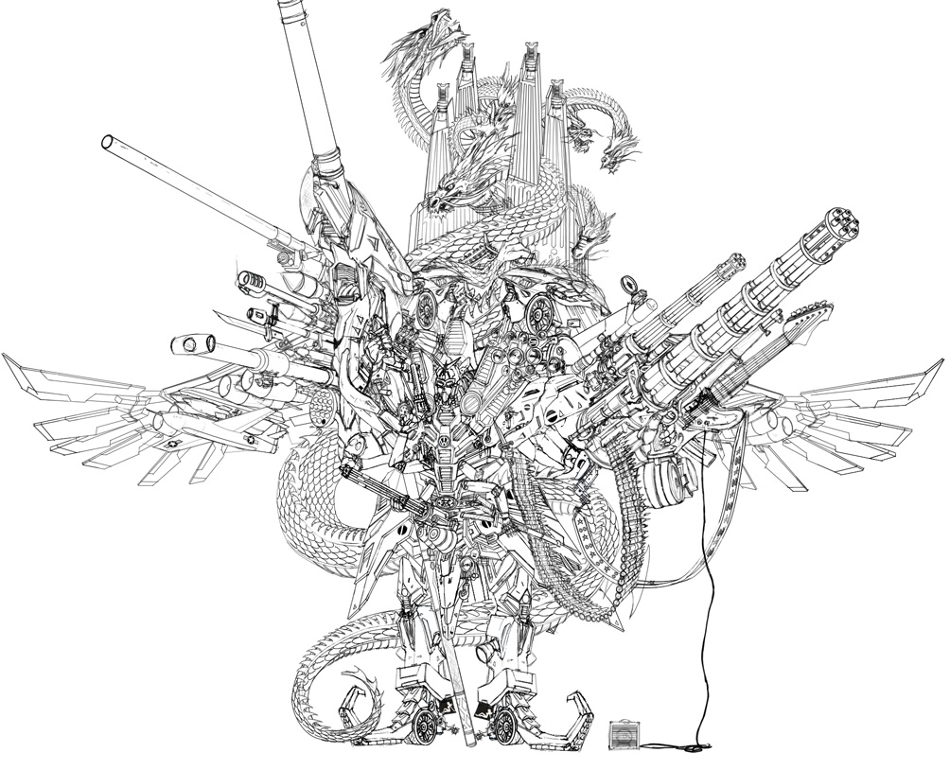
Detailed line works
show the beauty of a drawing

Slide 20
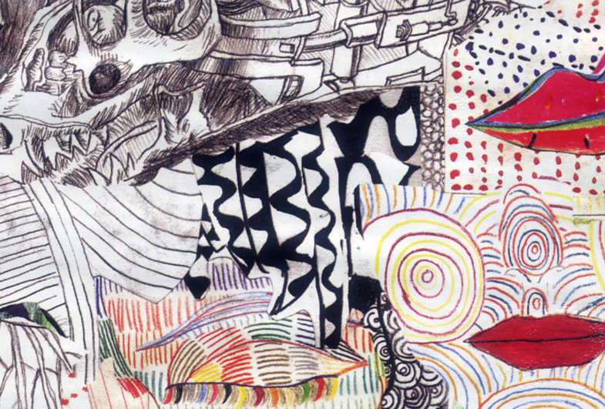
What kind of lines can we see here?
Outlines
5
Straight,
Parallel
Lines
1
Dotted Lines
7
4
Zig-zags
Spirals &
Curvy Lines
6
Vertical &
Horizontal
Lines
2
Dashed Lines
3
5
Thick & Thin Lines
3
Notes:
What kind of lines can we see here?
Straight, parallel lines
Vertical & horizontal lines
Dashed lines
Zig-zags
Thick and thin lines
Spirals and curvy lines
Dotted lines
Outlines

Slide 21
Your Task
Draw your hand

Slide 23
THE END

