Slide 1
Van Gogh’s Chair Pop-ups
Why do you think Van Gogh draw this chair?
“Empty chairs have frequently been used as the personification of the people who own them.”

Slide 2
Your task
You are going to design a chair that personify you.
Design the background of the room that personify you as well.
At the end of the lesson, describe in your sketchbook about the art work and how the work is related to you. In other words, you are creating an ARTIST STATEMENT. Also, include a ‘title’.
Now, let’s look at some example:

Slide 3
Van Gogh’s Pop Up Chair

Slide 6
What You Need:
A4 Paper
Marker
Scissors
Colouring materials
Let’s look at how to do a Van Gogh’s Pop Up Chair.

Slide 7
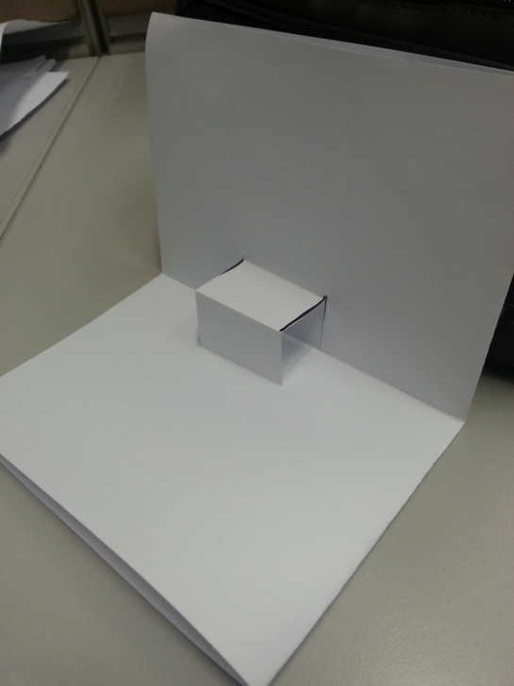
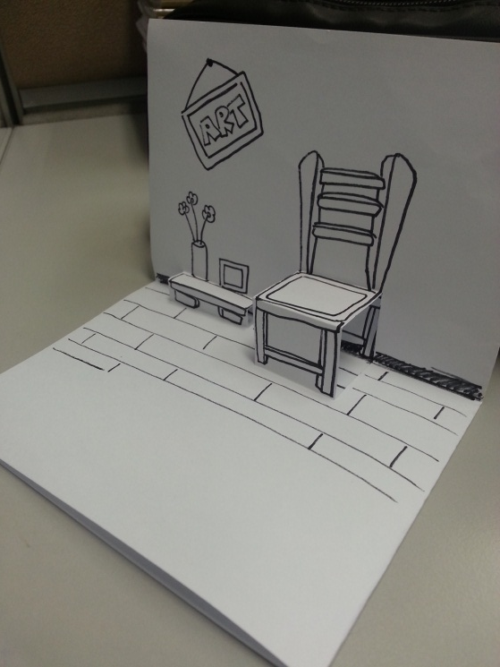
Step 1
Fold into 4 parts
Step 2
Cut along the black lines
Step 5
Colour
Step 3
Fold to get this
Step 4
Draw your design

Slide 8
It’s your turn!
Be as creative as you can.

