Slide 1
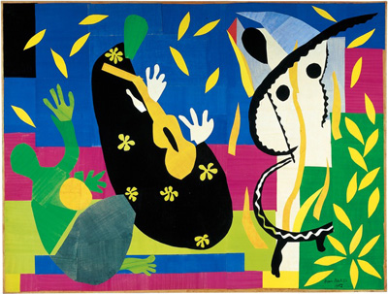
THINK
What do you think about this Artwork?
PUZZLE
What questions do you have?
EXPLORE
What does the artwork make you want to explore?
The Sorrows of the King (1952)
Dimensions: 2.92 m x 3.9 m
Media: Paper, Gouache
Notes:
In mid-40s to early 1950s, he suffered from poor health and was diagnosed with cancer. Was wheelchair- bound so he couldn’t stand up and paint. But even as he was sick, he still want to create art. So he create a different art form which is paper collage.
He is heavily influenced by other cultures and having seen exhibitions in Asia and travelled to North Africa, he incorporated some of the decorative elements in Islamic art, the angularity of African sculptures and the flatness of Japanese prints and make it his own style.
Can you spot the elements in this artwork? Colours? Shapes? Patterns?
Elements:
Humans, what are they doing?
Animals, hiding
Visual litWhat do you think the story is in this painting? - RESEARCH.

Slide 2
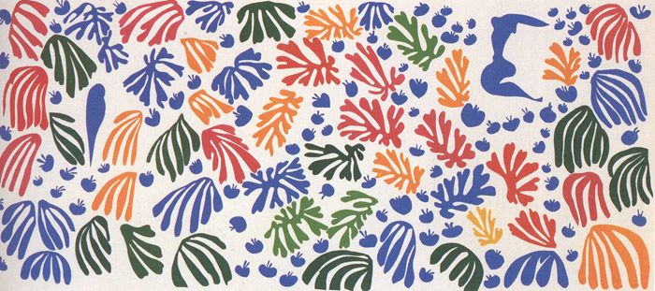
HENRI MATISSE (31 December 1869 – 3 November 1954)
Drawing With Scissors
Notes:
Introduction to Henri Matisse
http://www.metmuseum.org/toah/hd/mati/hd_mati.htm

Slide 3
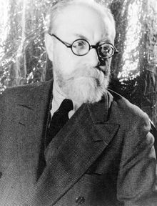
HENRI MATISSE (31 December 1869 – 3 November 1954)
French painter, printmaker, sculptor & draughtsman
Fauvist (1900-1910), & abstract impressionist artist
Inspired by Islamic Art, Japanese prints and African sculptures
Notes:
He is a draughtsman, printmaker, and sculptor, but is known primarily as a painter
During Fauvism in 1900s- 1910s, the paintings expressed emotion with wild, often dissonant colours, without regard for the subject's natural colours.
FAUVIST- WILD BEAST IN FRENCH

Slide 4
Video Time!
Do observe how Henri Matisse create his artwork.

Slide 5
WHAT IS ABSTRACT ART?
Art that does not attempt to represent the external, recognizable reality but seeks to achieve its effect using shapes, forms, colours, and textures.
Notes:
What is abstract art?

Slide 6
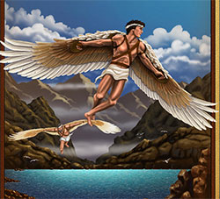
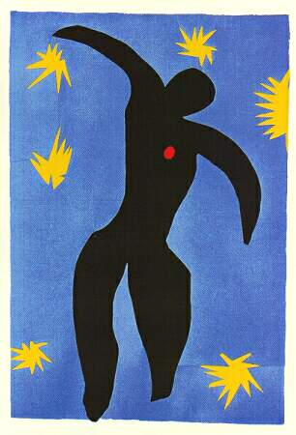
REPRESENTATIONAL
ABSTRACT
The legend of Icarus, the boy who flew too close to the sun. and plunged to his death.
The Fall of Icarus, 1947, from Jazz,
Henri Matisse.

Slide 7
What is Composition in Art?
Composition in Art refers to the arrangements of the elements in or the subject matter of a painting or photograph.
A successful composition draws in the viewer and pulls their eye across the whole artwork. The composition finally settles on the main subject.

Slide 8
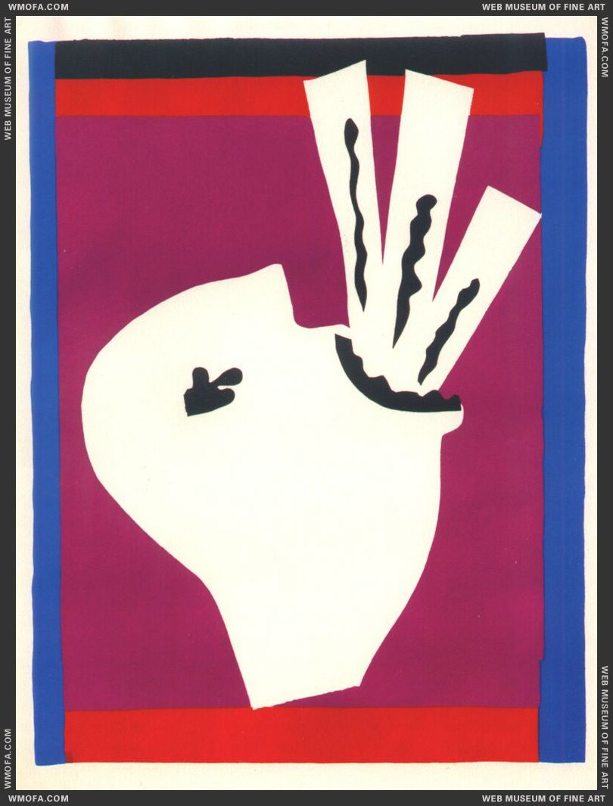
Le Clown, from Jazz (1947) .
Jazz is an artist's book of about one hundred prints based on paper cutouts by Henri Matisse.
The Sword Swallower, 1947, Jazz.
Notes:
Look at the form of human that he created, the body shape, the head. Not representing the real shape of form but it looks somewhat alike, can guess.

Slide 9
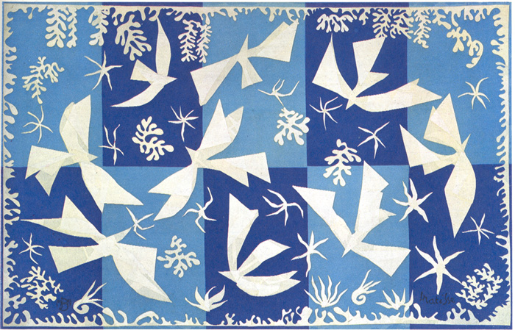
Polinesia, The Sky (1946)
Dimensions: 196 x 312 cm

Slide 10
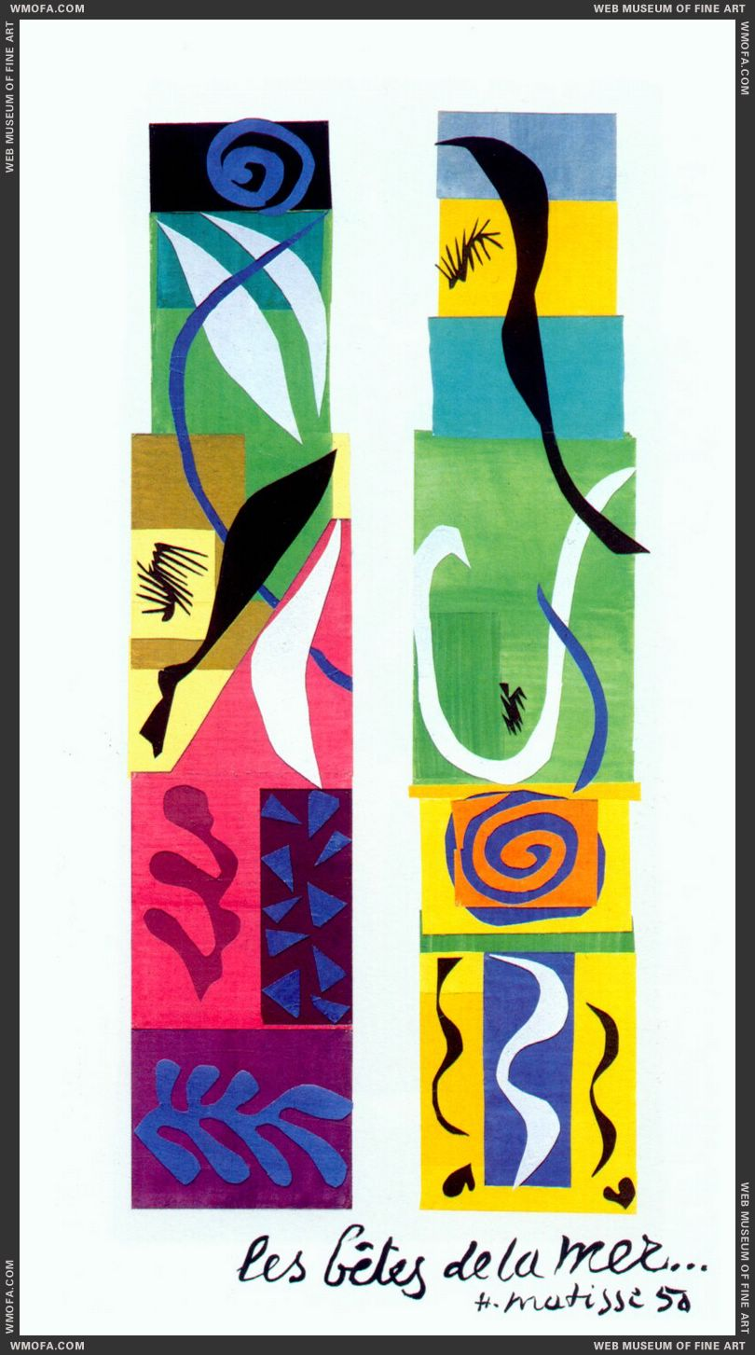
Beasts of the Sea (1950)
Dimensions: 2.96 m x 1.54 m
Media: Paper collage

Slide 11
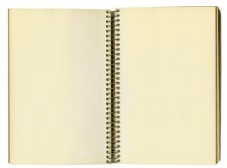
You are going to be Henri Matisse today. You are going to draw with scissors.
Note:
Minimize wastage of paper. Share the coloured paper.
ACTIVITY
EXPLORATION
OF
ABSTRACT
FORMS

Slide 12
Your Challenge
You are going to create an artwork with the theme “Movement’.
Some questions to get you started:
What do you think is a movement?
What are things that move?
What causes movement?
For this artwork, you are going to use a limited palette. In other words, on top of black and white, you may work with maximum two colours.
Note:
Work with different shades and tints of a colour.
No pencil is allowed.
How many colours did Henri Matisse use for this artwork?
Ans: 2 – White and Blue

Slide 13
ARTIST STATEMENT
Write a short paragraph about your artwork based on the theme “Movement”.
Notes:
Teacher to wrap up the unit

